Slide 1
What’s Your Strategic Plan? Landscape Ontario
Virtual
March 14, 2022

Slide 2
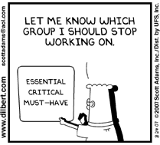
Learning Agenda
Defining your practical vision
Understanding and defining your revenue growth drivers
Value proposition and target markets
Strategic imperatives
Converting your one-page plan into action

Slide 3
Feel Free to Get in Touch
For templates or guidance, just email me: peter.wright@theplanninggroup.ca
Call me: 519 740 2725
Visit our website https://www.theplanninggroup.ca/

Slide 4


My Biases
If the act of planning doesn’t drive significantly better results…than operating without formal planning…don’t waste your time
There must be a clear cost benefit
Your plan must cause/force you to go beyond where momentum will take you
My Favourite Topic

Slide 5
“Plans are useless, planning is indispensable.”
- Dwight Eisenhower

Slide 6


Specific Words About The Current Crisis
Covid
19
Discipline and process is more important now than ever
Be deliberate, be concise, don’t assume
Short and frequent interactions
Stop and regroup your plan more than normal
Decision rigor is more important than ever
Discipline is more important than ever

Slide 7
The Case for Business Planning
Can just having a business plan actually help small businesses make more money?
Can it reduce uncertainty?
Do you know how you add value?
What sets you apart from your competitors?

Slide 8

But First…
Why Strategy?
Making strategy should drive better results…otherwise, why do it?
Good Strategy
Drives Performance
Good Strategy
Drives Productivity
Good Strategy
Drives Profitability
Strategy is the single most important factor in organizational performance
Firms with top decile strategy are more productive (and profitable) than peer companies by 2-5 times
Getting trustee, admin and staff alignment on strategy will actually drive profitability
What Drives Productivity? Chad Syverson home.uchicago.edu/syverson/productivitysurvey.pdf

Slide 9
The Case for Business Planning
Is there a cost benefit to giving up billable time, or family time to work on your plan?
The simple equation of course is to ensure that:
The costs/time/complexity of planning ahead are minimized
Your plan must cause/force you to go beyond the status quo, and go beyond where momentum will take you

Slide 10
Planning for The Right Reasons
It must be all about you!
Create your plan to help you run your business better and achieve bigger goals
You are your own boss, and your plan does not need to answer to anyone
A comparison to big business
You have the added benefit of being able to carefully blend in your personal goals and aspirations

Slide 11
The Case for Planning Continues
We have all heard the expression “how can you get somewhere if you don’t know where you are going?”…yet we are all guilty of doing this every day
The vacation without a plan
The case for focus
The case for stretch objectives
The biggest side benefit of planning for small business is the removal…or at least reduction of uncertainty

Slide 12
What Does a Plan Actually Do?
It forces you to stop and take stock
Where are we today?
What has worked well for us, and what has not?
What are the primary strengths of this business and of me personally?
What are the weaknesses that we really should overcome if we hope to be successful?
It forces you to think about the future
What are the handle of opportunities that I would be crazy not to exploit?
What are the obstacles that are going to stand between where we are and where we want to be?

Slide 13
What Does a Plan Actually Do?
Your plan creates the blueprint to take your business beyond business as usual
Your plan is your picture of a business that is much better in the future than status quo will ever get you…and then forces you to come up with creative ways to get there

Slide 14
“It's difficult to make predictions - especially about the future.”
- Yogi Berra

Slide 15
The Integrated Planning Model
Strategic targets
Revenue Mix
Reserves
LTFP, etc…
Strategic Planning
Mission
Vision
Practical Vision
Values
Strategy
Strategic Imperatives
Operational targets
Program Objectives, etc…
Increasing level of detail
Operational Planning
Performance Metrics
Summary of how the Strategic Imperatives will be achieved
Copyright @ 2022 The Planning Group
Budgets
Project targets
Project & Action Planning
Detailed 90 Day plans to execute the operational plans
Project Plans

Slide 16
Strategic Imperatives Fill the Strategy Gap
PV
Strategic Gap
Strategic
Imperatives
Performance
OI
Operational Improvements
CS
Operations
2022
2023
2024
2025

Slide 17
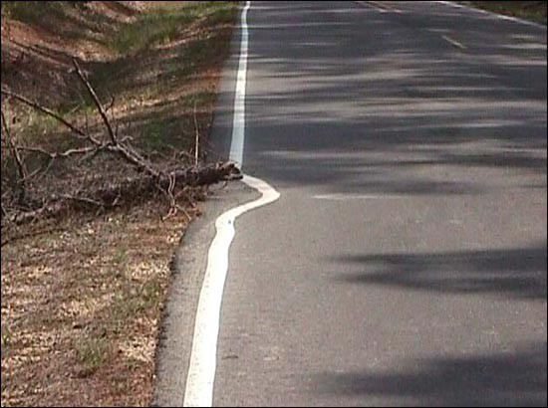
A Business Without a Plan

Slide 18
“You can't prepare for everything, but you can prepare for anything.”
- Paul Youngjohns
Notes:
This is a theme we will revisit throughout our discussion today.
We will talk specifically about board effectiveness in normal times and times of crisis.

Slide 19
A Taste of Planning
Start with the Small Business Planning Template and start on page 1:
Define your Operating Environment
Key Strengths, Assets and Differentiators
Opportunities
Brainstorm your Practical Vision
Define your Weaknesses and Obstacles
Define your Strategic Imperatives
Create your personal action plan

Slide 20
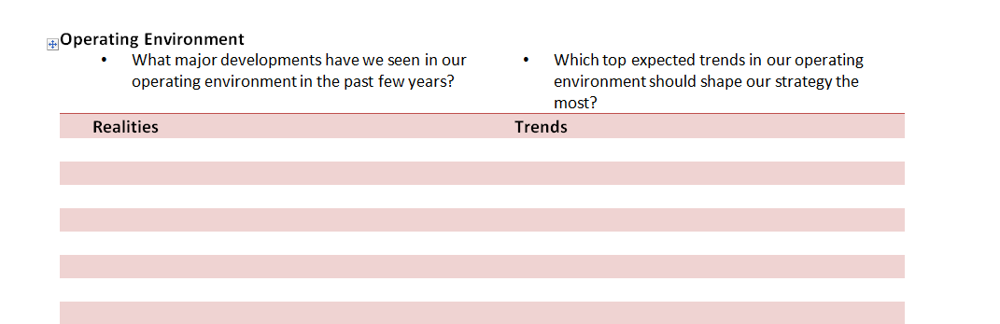
Understanding External Strategic Drivers

Slide 21
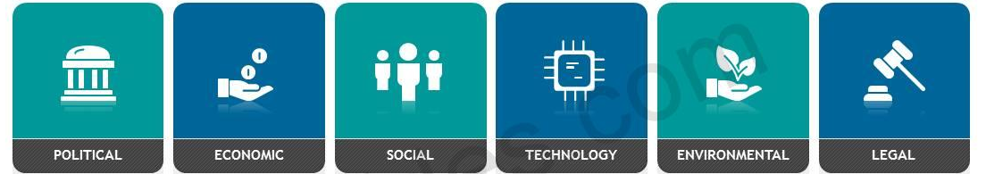
Your Operating Environment
What technology, economic, regulatory and competitive trends do you expect in the landscaping markets and applications you serve in the coming years?
How might these trends impact the needs and expectations of your customers and prospective customers?
How might these trends impact the marketing positioning of your competitors?

Slide 22
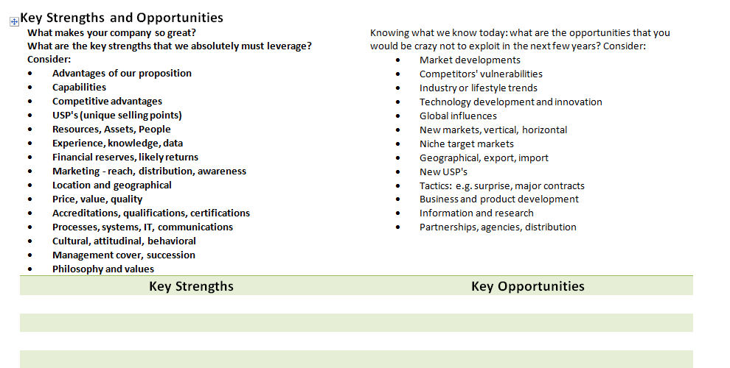
Understanding Internal Strategic Drivers

Slide 23
Understanding Growth Drivers
If you want to grow from $500K in sales to $1M (or $20M-$25M) in the next 3 years: where do you want most of that growth to come from? Consider:
Deeper share of wallet with existing customers?
New customers?
Pricing? Bundling?
New services and products?
Same stuff in a new geography?
Etc.
Notes:
Don’t say you want it all.

Slide 24
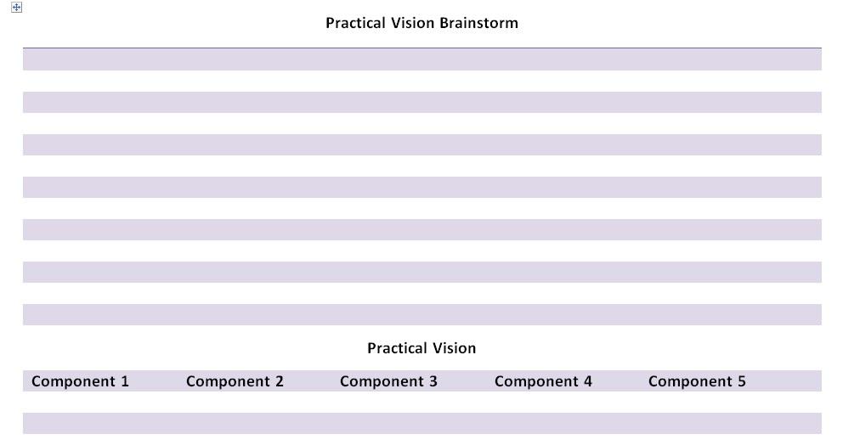
What would you like to be able to say about your company in 3 short years? Specifically what will you be able to say about:
People and employees
Processes and efficiencies
Capabilities
Services and offerings
Customers
Revenue and profitability
Reach and scope

Slide 25
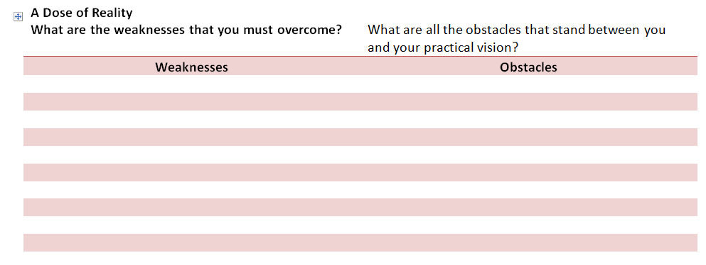

Slide 26
Strategic Imperatives Fill the Strategy Gap
PV
Strategic Gap
Strategic
Imperatives
Performance
OI
Operational Improvements
CS
Operations
2022
2023
2024
2025

Slide 27
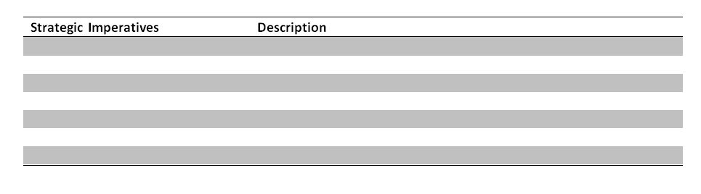
Strategic Imperatives

Slide 28
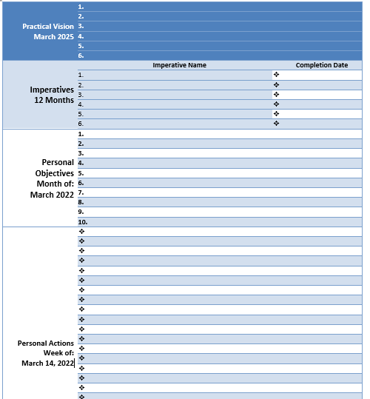
Summary Sheet

Slide 29
Putting Your Plan Into Action
Start with your summarized Practical Vision and Strategic Imperatives on the last page
Define the personal objectives that you need to accomplish every month to make your personal contribution to your company imperatives
Define the personal actions you need to accomplish every week to accomplish your personal objectives, and your job…this becomes your “to do” list
Update your personal objectives monthly
Update your personal objectives weekly

Slide 30
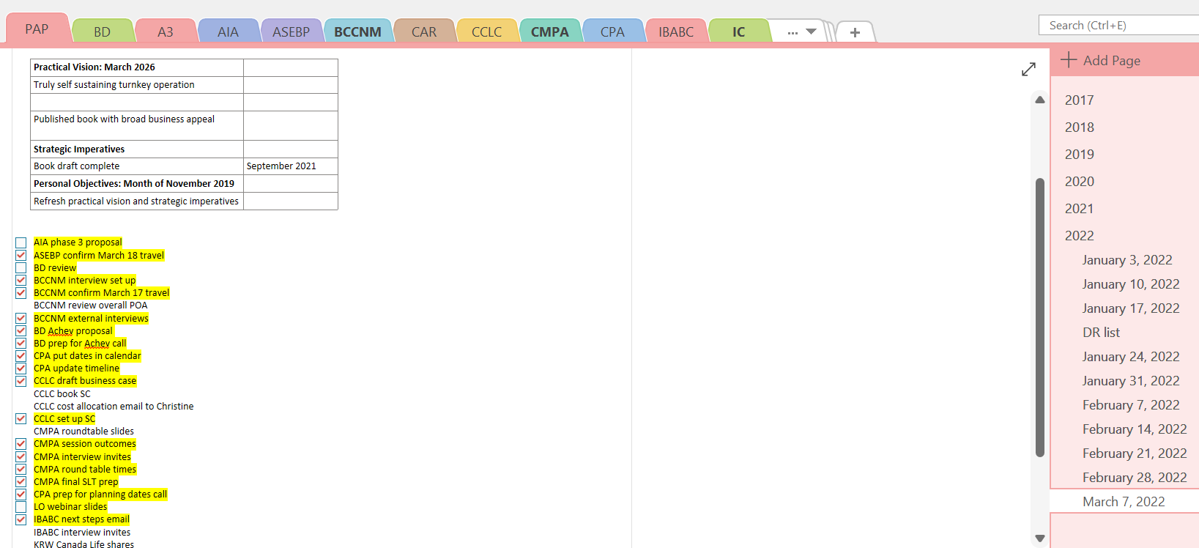

Slide 31
Principles of Planning for Small Business
Be pragmatic
Do just enough planning to get by and keep it simple
Get as much help as possible…and be open to constructive criticism and advice
Put it in writing…no matter what!
Use up 50% of your “discipline bank” to keep your planning on track
Schedule time every week…and protect that time at all cost

Slide 32
Tips to Make Planning Stick
Start at the top and work down…think about your vacation plans
Stick to a routine…no matter what
Get visual…and visible
Start today
Build your vision and priorities into your elevator pitch

Slide 33
Thank You

Slide 34
“When you don't know what to do, walk fast and look worried.”
- Dilbert

